Slide 1
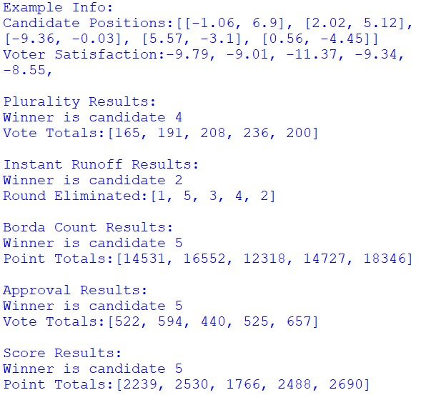
Devember Project: Voting Sim
Sam L

Slide 2

Other voting systems
Styles include:
Plurality,
Borda Count,
Instant Runoff,
Condorcet (e.g., Kemeny-Young),
Approval,
Score

Slide 3


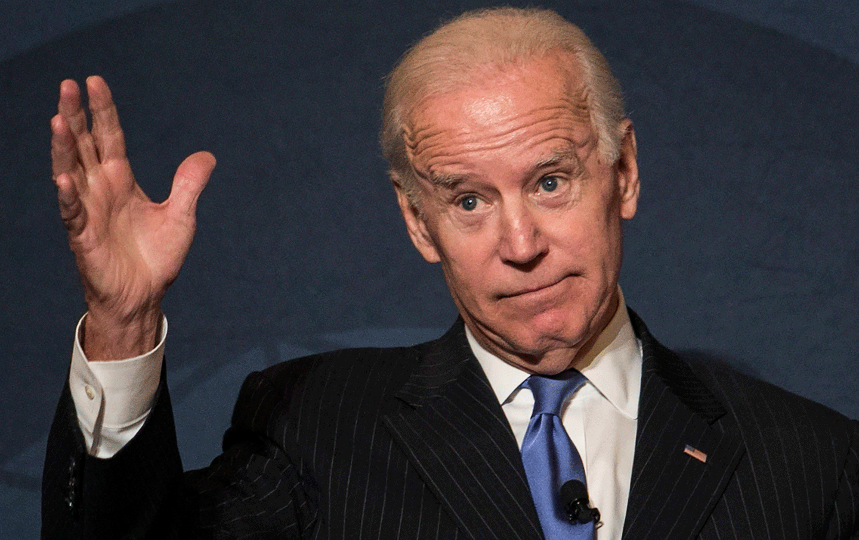
Why Care?
How many people vote for a candidate they actually like?
“Lesser of two evils”

Slide 4
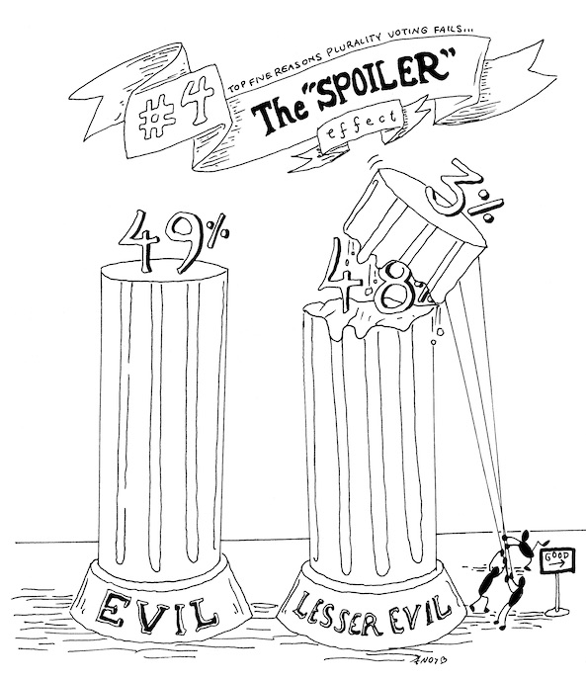

Q: Why can’t we have 3rd candidates now? A: The spoiler effect

Slide 5
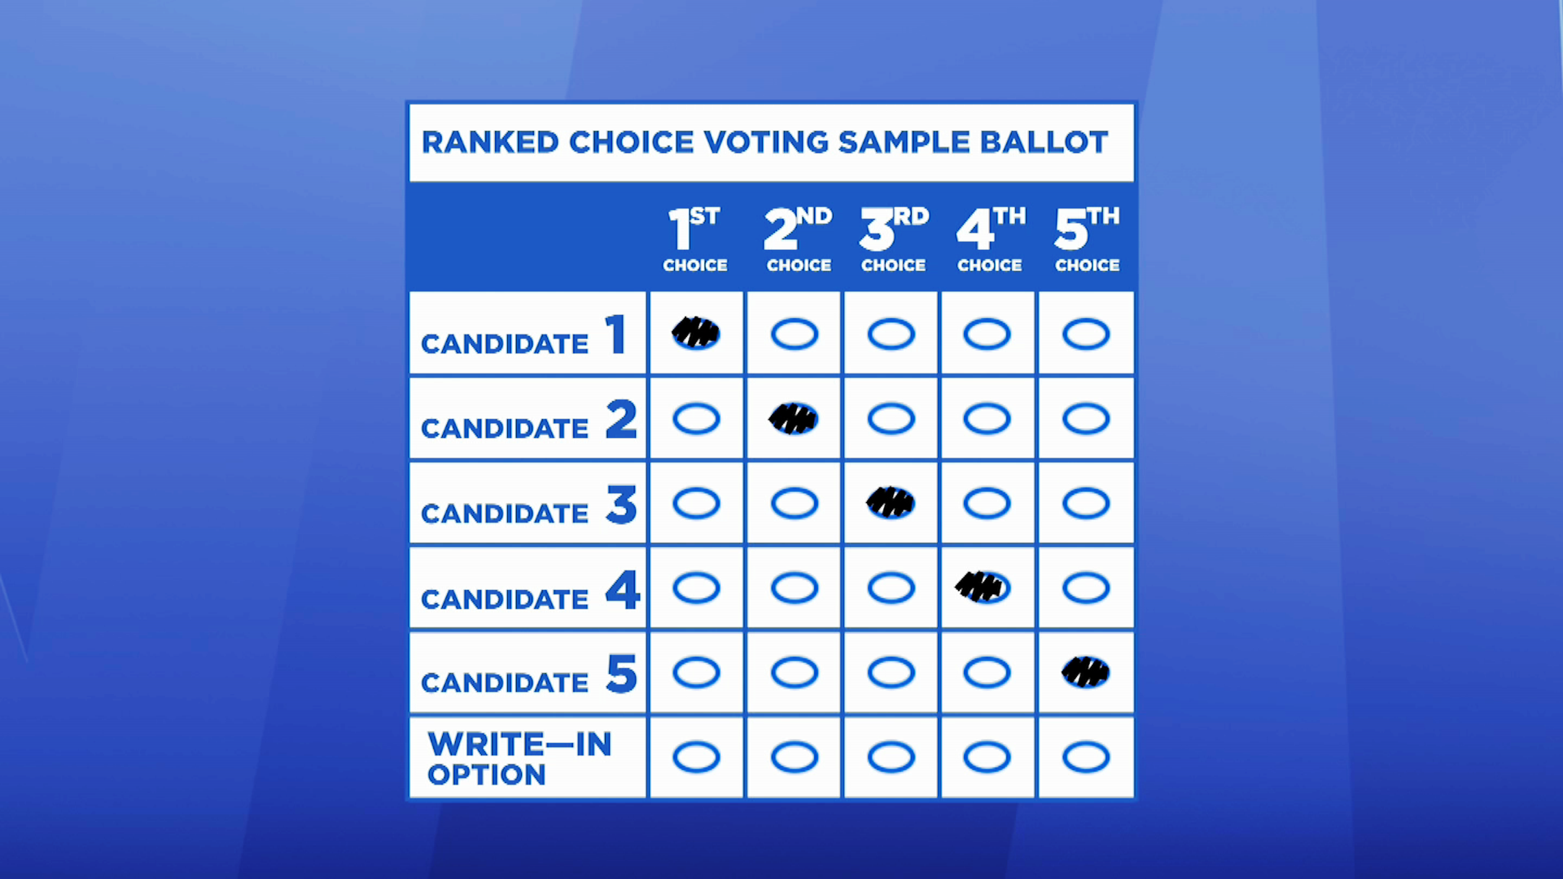
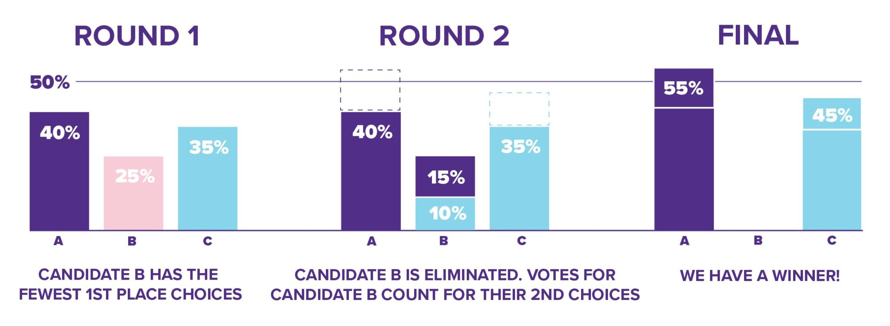
Instant Runoff voting
Voters rank candidates from favorite to least favorite

Slide 6
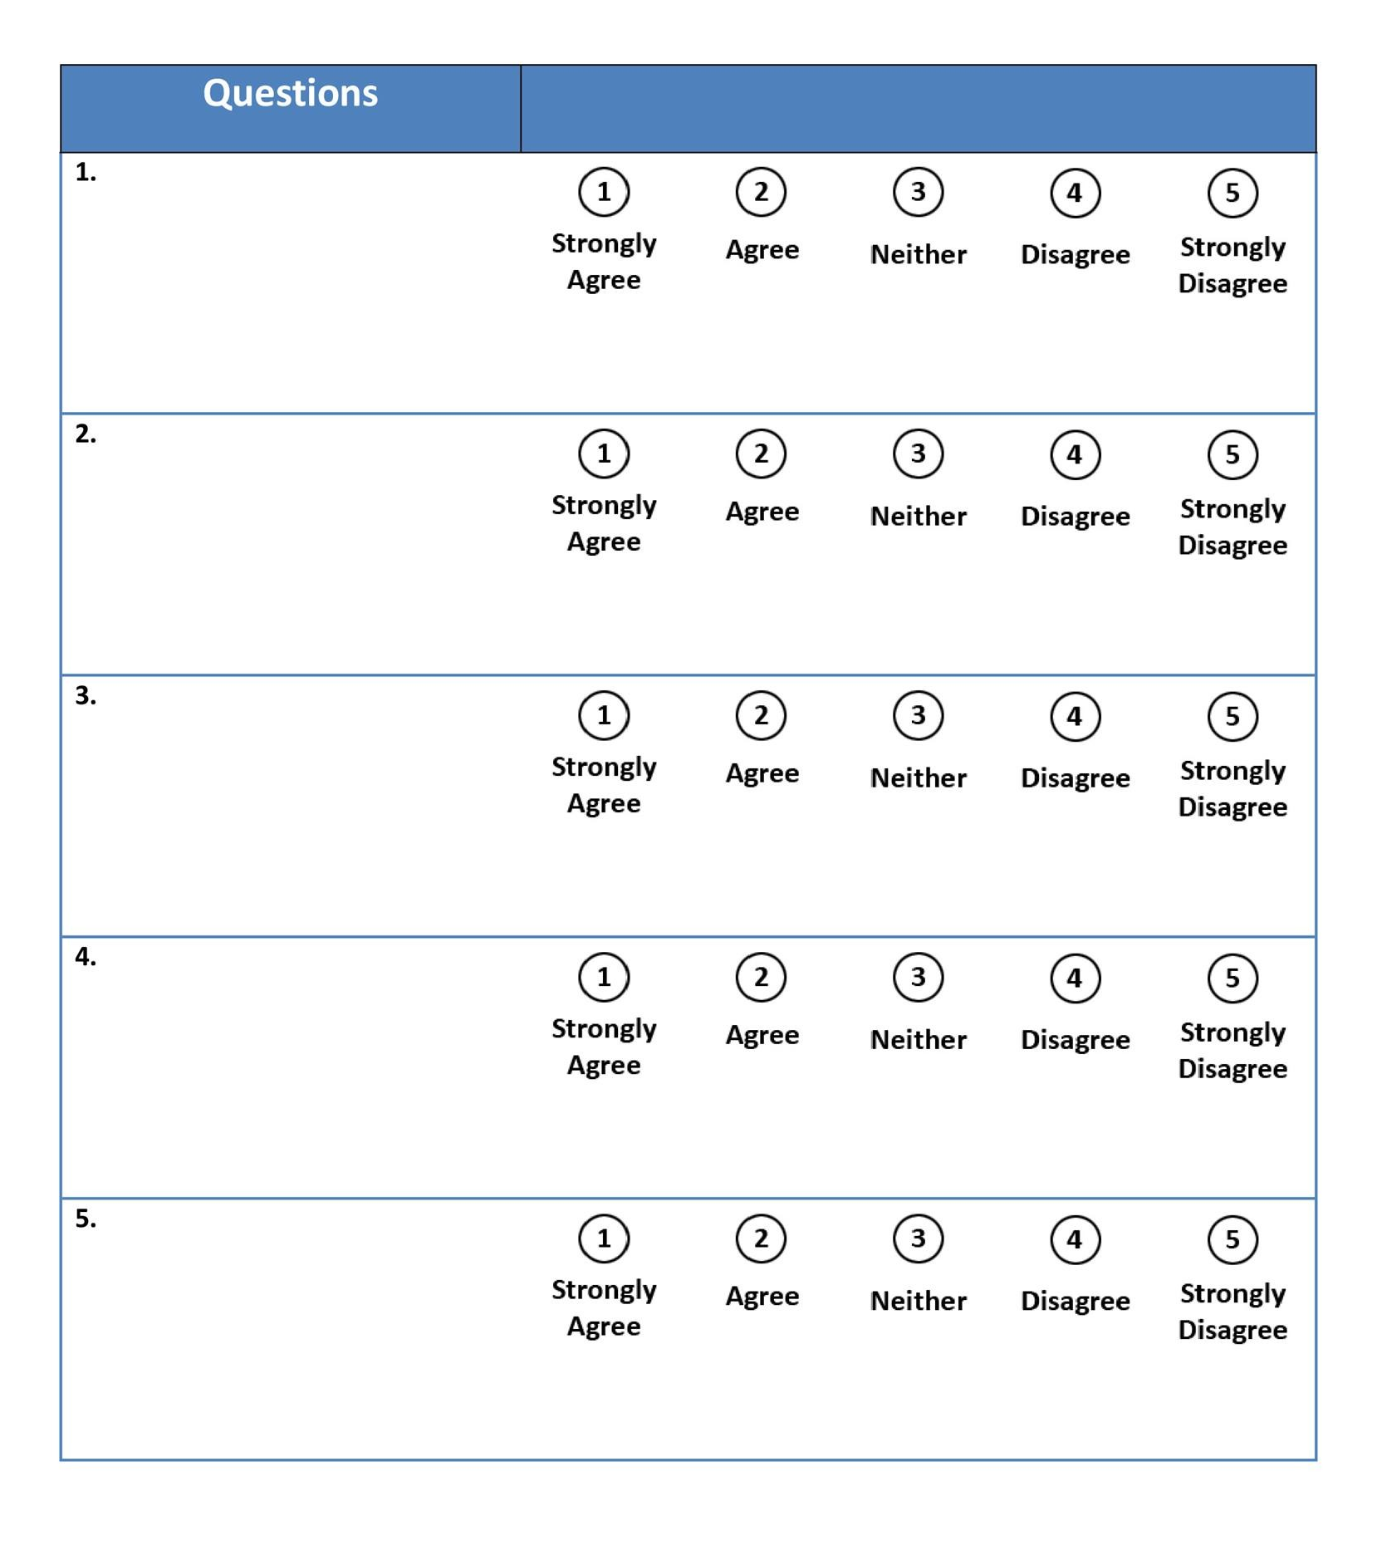
Score Voting

Slide 7
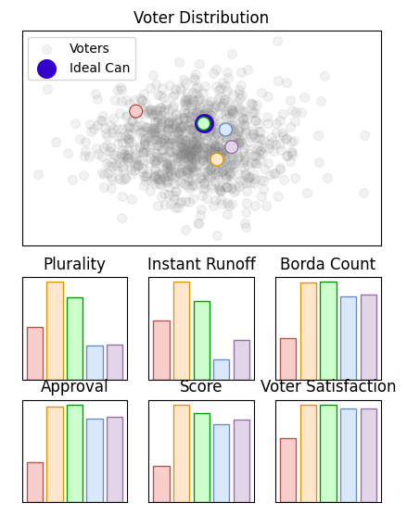
Simulation design
Everything is written in Python because python is easy
Voters and candidates are represented by points on a 2D space

Slide 8
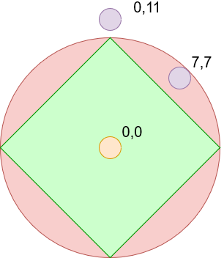

What’s the “right answer”?
Philosophical question
Usually minimum average distance
$$d= \sqrt{{\left(x_{2}−x_{1}\right)}^{2}+{(y_{2}−y_{1})}^{2}}$$
$$d={|(x}_{2}−x_{1})+(y_{2}− y_{1})|$$

Slide 9
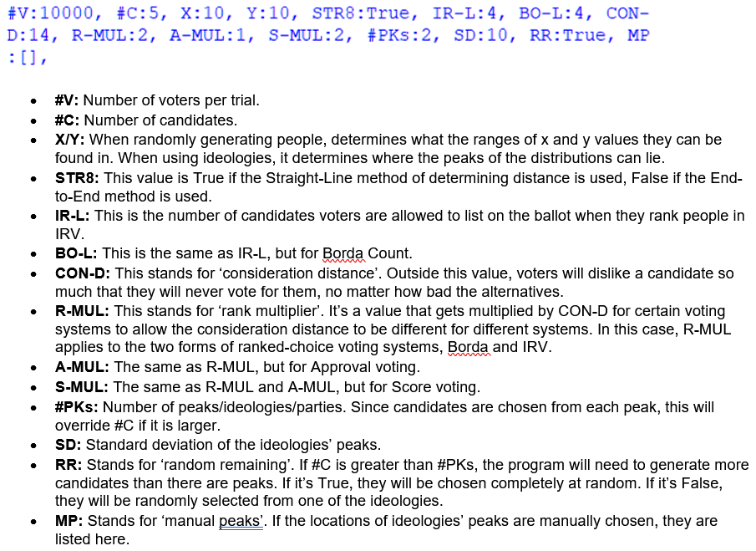
Variables

Slide 10
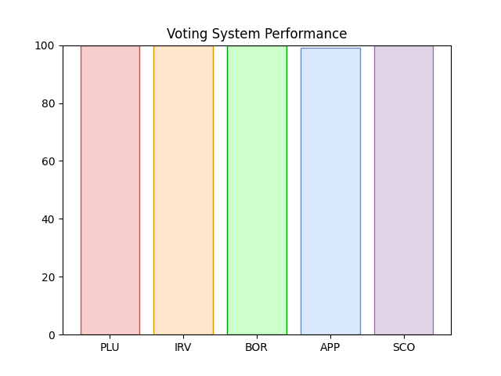
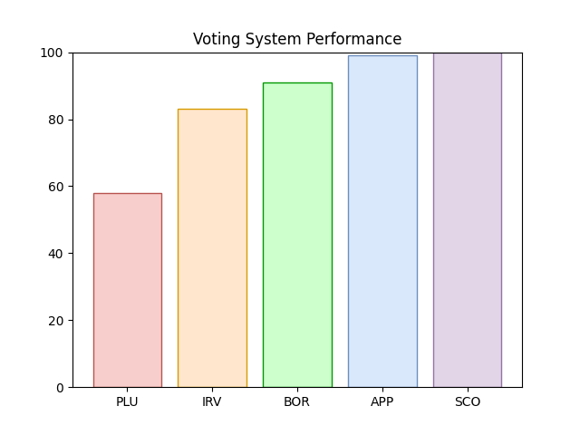
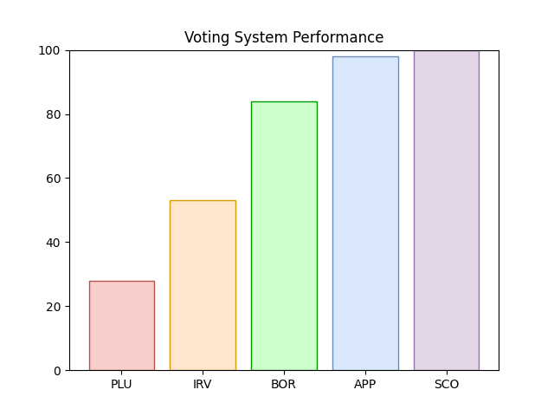
Number of candidates
2 5 10

Slide 11
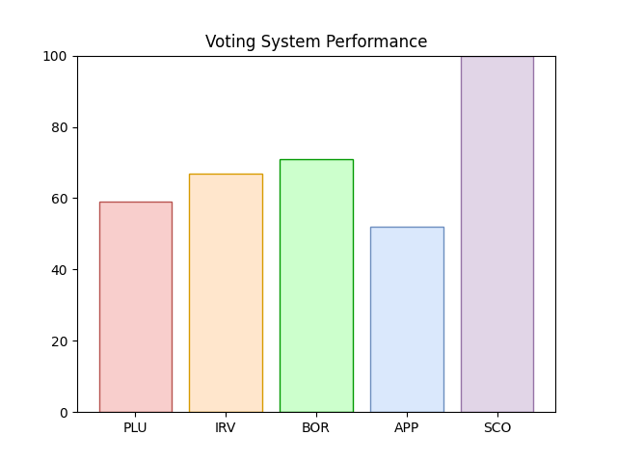
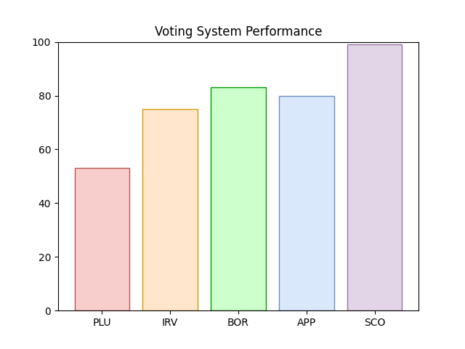
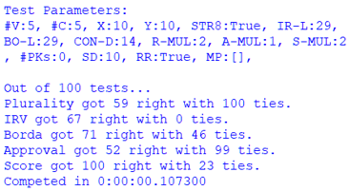
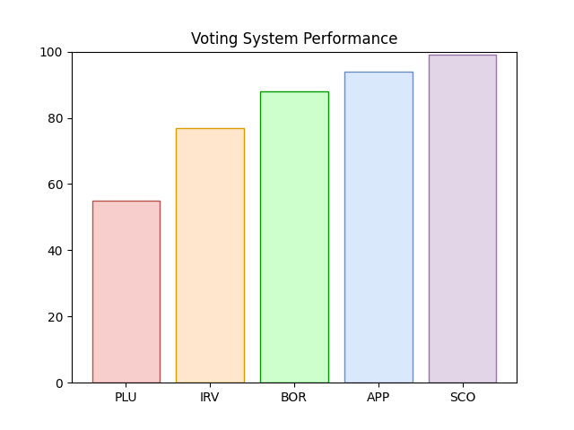
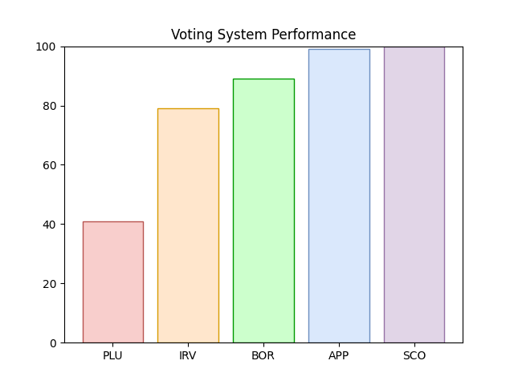
Number of voters
5 50
5000 500,000

Slide 12
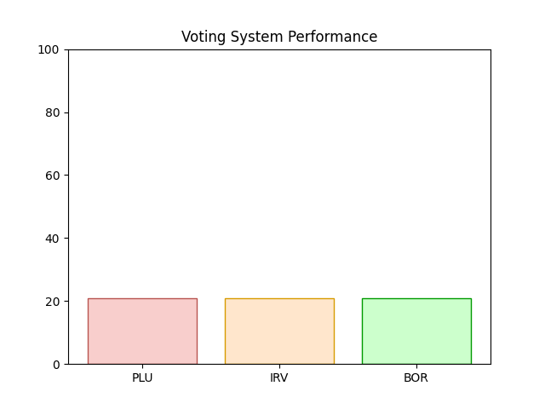
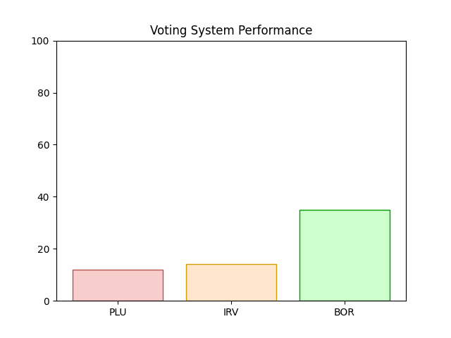
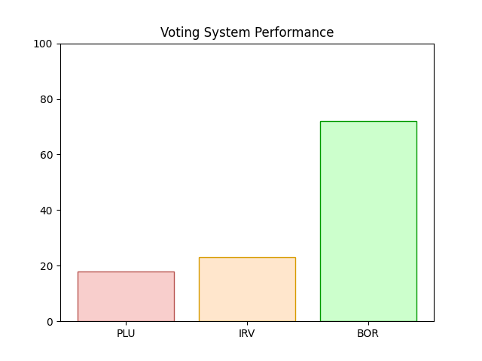
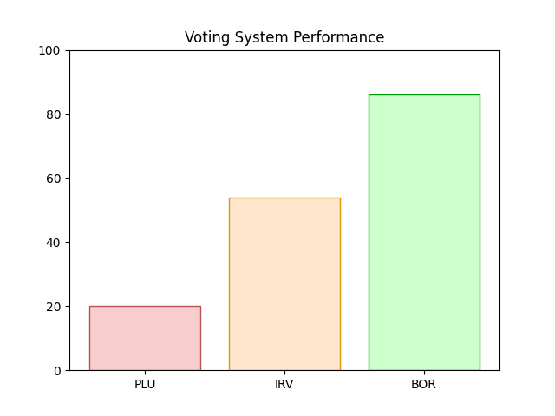
Limit on number of rankings
1 3 5 10

Slide 13
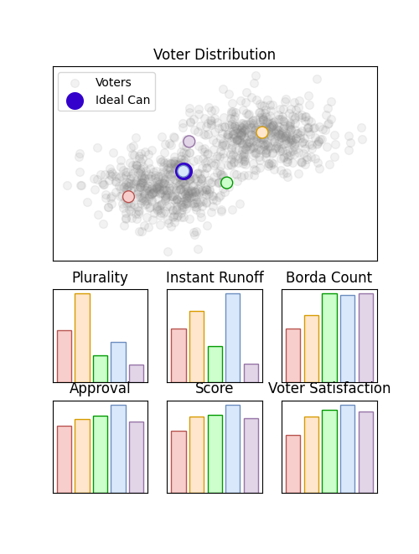
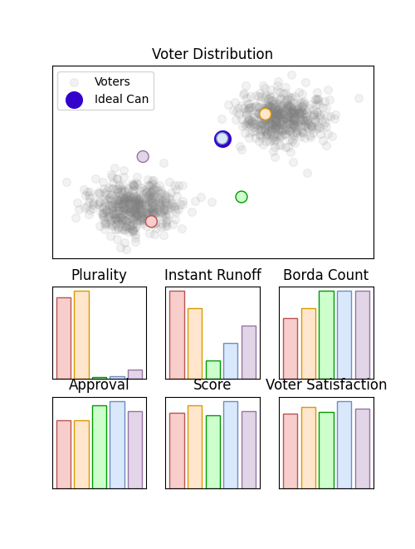
Party Polarization

Slide 14
Key Takeaways
Score > Approval ≈ Borda > IRV > Plurality > Random > Dictatorship
Ties are more common when # voters is low, Approval especially
Score is most resilient to a high # of candidates
Polarization doesn’t affect relative performance

Slide 15
Try it yourself
Code can be found at: https://github.com/sam8457/Voting-Sim
Don’t need to know any programming to play with the model, all the parameters are at the top of the text file, just play with those

